Slide 1
CSC1031: OOP
Week 4
Inheritance, overriding

Slide 2
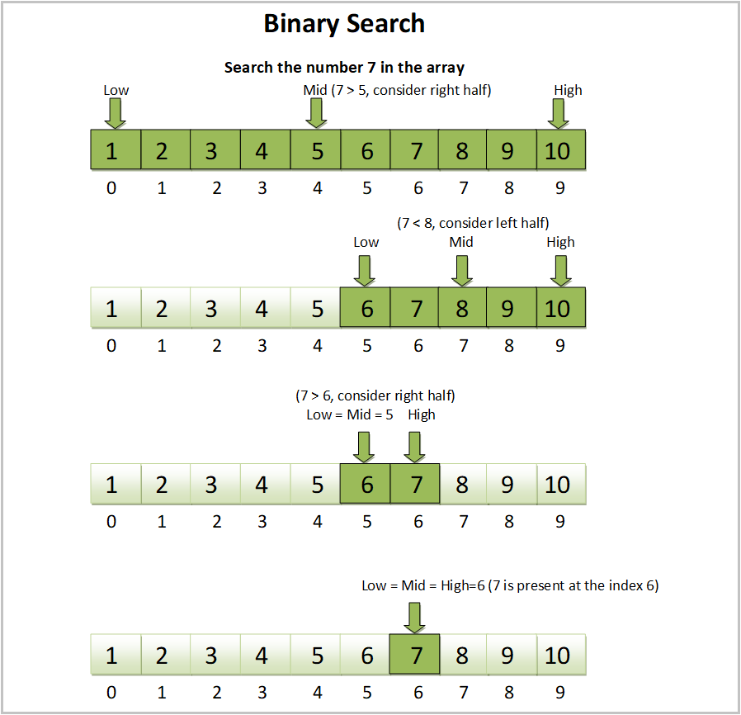
Binary search
Binary Search is an efficient searching algorithm used to find an element in a sorted array.
It follows a divide and conquer approach:
Find the middle element of the array.
If the target is equal to the middle element → Found!
If the target is smaller, search the left half.
If the target is greater, search the right half.
Repeat until the element is found or the search space is empty.

Slide 3
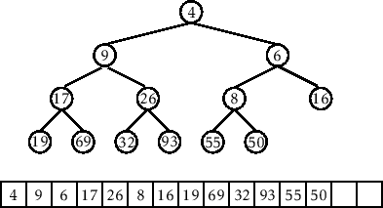
Binary Tree
A Binary Tree is a hierarchical data structure in which:
Each node has at most two children (left and right).
The topmost node is called the root.
The last-level nodes with no children are called leaf nodes.

Slide 4
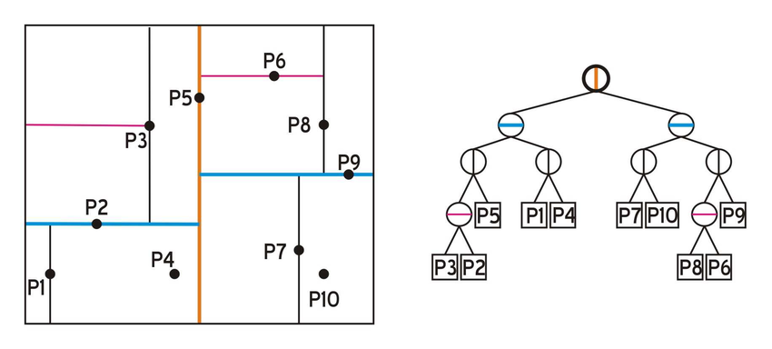
KD-tree (K-Dimensional Tree)

Slide 5
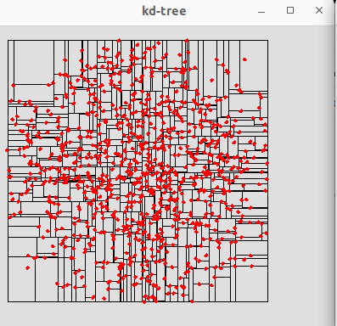
KD-tree (K-Dimensional Tree)
A KD Tree (k-dimensional tree) is a space-partitioning data structure used for efficient searching in multi-dimensional spaces.
It recursively divides the space into regions by selecting a pivot at each level
Mainly used for nearest neighbor search, range search, and clustering

Slide 6


Slide 7
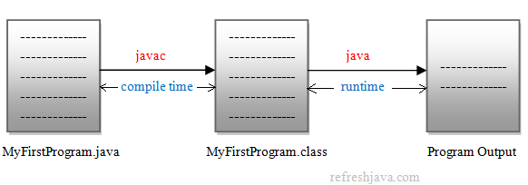
Compilation Errors vs. Runtime Errors in Java
Compilation Errors
Detected at compile time (before running the program).
Occur due to syntax mistakes, incorrect data types, missing semicolons, undeclared variables, etc.
int x = "hello"; // ❌ Type mismatch
Runtime Errors
Occur while the program is running, even if it compiled successfully.
Typically caused by invalid operations, such as dividing by zero, accessing a null reference, or exceeding array bounds.
int a = 10 / 0; // ❌ ArithmeticException

Slide 8



Introduction to Inheritance

Slide 9
Definition
Inheritance allows one class to acquire properties and methods of another class
Enables code reuse and extensibility.
class Parent {
int x = 10;
}
class Child extends Parent {
// Child inherits Parent
int y = 20;
}

Slide 10
Types of Inheritance in Java
Single Inheritance – One class inherits another
Multilevel Inheritance – A class inherits from a class that is already inherited
Hierarchical Inheritance – Multiple classes inherit from a single parent.
Java does not support multiple inheritance with classes

Slide 11
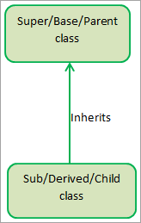
What is Single Inheritance?
Single Inheritance is a mechanism where a single child class inherits from a single parent class
The child class gains access to the fields and methods of the parent class, allowing code reuse and extension
It promotes modularity and reduces redundancy in code.

Slide 12
Syntax of Single Inheritance
class Parent {
void show() { System.out.println("This is the Parent class"); }
}
class Child extends Parent {
void display() { System.out.println("This is the Child class"); }
}

Slide 13
Syntax of Single Inheritance
The extends keyword is used to inherit from a class
class Parent {
void show() { System.out.println("This is the Parent class"); }
}
class Child extends Parent {
void display() { System.out.println("This is the Child class"); }
}
public class Main {
public static void main(String[] args) {
Child obj = new Child();
obj.show(); // Inherited method
obj.display(); // Child class method
}
}
The child class gets access to non-private members of the parent class

Slide 14
Single Inheritance
Code Reusability – Avoids writing duplicate code.
Improves Maintainability – Changes in the parent class automatically reflect in the child class.
Extensibility – Allows adding new functionality in derived classes without modifying the parent.
Banking Systems:
BankAccount → SavingsAccount
E-commerce Platforms:
User → VIP User
Automobile Industry:
Car → Electric Car

Slide 15
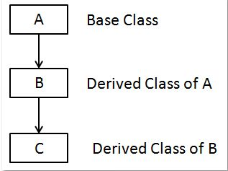
What is Multilevel Inheritance?
Multilevel Inheritance occurs when a class derives from a child class, which itself extends another class.
It forms a chain of inheritance, where properties and methods are passed down through multiple levels.
Grandparent → Parent → Child

Slide 16
Syntax of Multilevel Inheritance
class Grandparent {
void grandparentMethod() { System.out.println("Grandparent method"); }
}

Slide 17
Syntax of Multilevel Inheritance
class Grandparent {
void grandparentMethod() { System.out.println("Grandparent method"); }
}
class Parent extends Grandparent {
void parentMethod() { System.out.println("Parent method"); }
}

Slide 18
Syntax of Multilevel Inheritance
class Grandparent {
void grandparentMethod() { System.out.println("Grandparent method"); }
}
class Parent extends Grandparent {
void parentMethod() { System.out.println("Parent method"); }
}
class Child extends Parent {
void childMethod() { System.out.println("Child method"); }
}

Slide 19
Syntax of Multilevel Inheritance
class Grandparent {
void grandparentMethod() { System.out.println("Grandparent method"); }
}
class Parent extends Grandparent {
void parentMethod() { System.out.println("Parent method"); }
}
class Child extends Parent {
void childMethod() { System.out.println("Child method"); }
}
public class Main {
public static void main(String[] args) {
Child obj = new Child();
obj.grandparentMethod(); // Inherited from Grandparent
obj.parentMethod(); // Inherited from Parent
obj.childMethod(); // Defined in Child
}
}

Slide 20
Examples
Banking System
BankAccount → SavingsAccount → PremiumSavingsAccount
Automobile Industry
Vehicle → Car → ElectricCar
Education System
Person → Student → GraduateStudent
Employee Hierarchy
Employee → Manager → SeniorManager

Slide 21
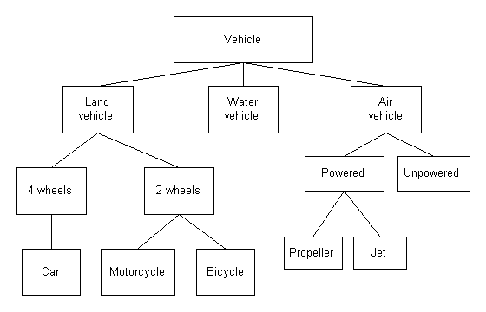

Slide 22
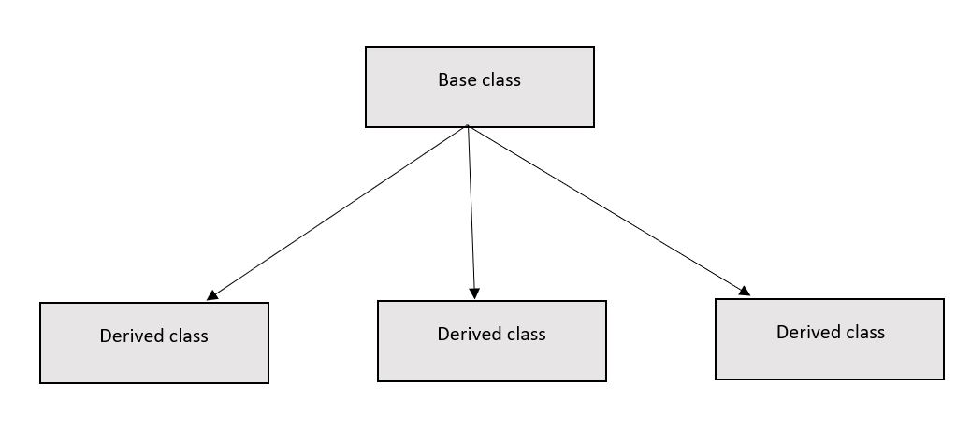
What is Hierarchical Inheritance?
Hierarchical Inheritance occurs when multiple child classes inherit from a single parent class.
Each child class inherits common properties and methods from the parent while defining its own behavior.
It allows code reuse and promotes an organized structure.
One Parent → Multiple Children

Slide 23
Syntax of Hierarchical Inheritance
class Parent {
void commonMethod() { System.out.println("Common method from Parent class"); }
}
class Child1 extends Parent {
void child1Method() { System.out.println("Child1-specific method"); }
}
class Child2 extends Parent {
void child2Method() { System.out.println("Child2-specific method"); }
}
public class Main {
public static void main(String[] args) {
Child1 obj1 = new Child1();
obj1.commonMethod(); // Inherited from Parent
obj1.child1Method(); // Child1 method
Child2 obj2 = new Child2();
obj2.commonMethod(); // Inherited from Parent
obj2.child2Method(); // Child2 method
}
}

Slide 24
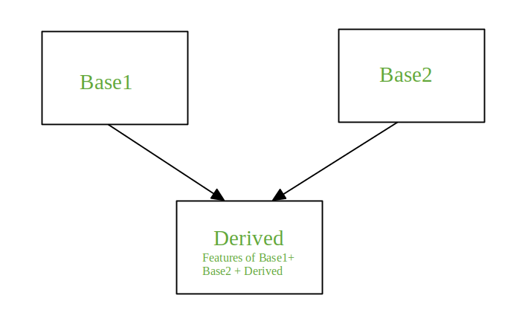
What is Multiple Inheritance?
Multiple Inheritance is when a child class inherits from two or more parent classes.
Java does NOT support multiple inheritance with classes to prevent ambiguity issues (Diamond Problem).
However, Java supports multiple inheritance using interfaces.

Slide 25
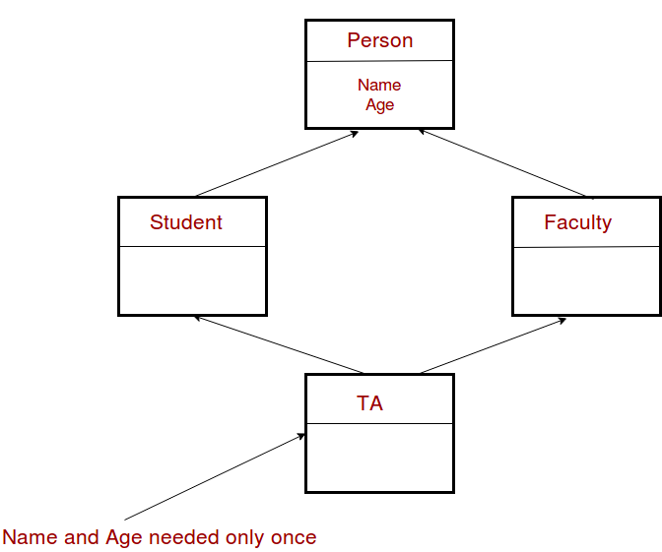
Why Java Does Not Support Multiple Inheritance?
Ambiguity Problem
(Diamond Problem)
If two parent classes have the same method and the child class inherits from both, which method should be called?
This leads to compiler confusion and possible runtime errors.

Slide 26
Applications of Multiple Inheritance
E-Commerce System: User Roles
Buyer and Seller → User implements both.
Automobile Industry: Hybrid Vehicles
ElectricVehicle and FuelVehicle → HybridCar implements both.
Banking System: Multiple Account Features
LoanAccount and SavingsAccount → UserAccount implements both.

Slide 27
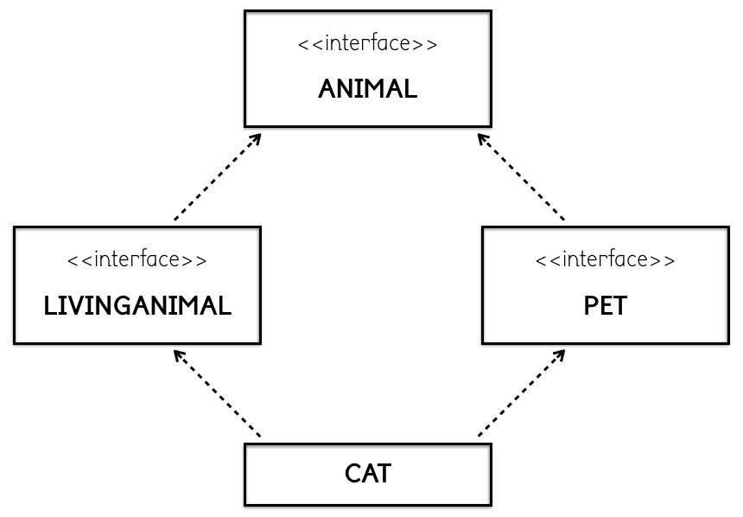
What is an Interface in Java?
An interface in Java is a blueprint of a class that contains only abstract methods and constant variables.
Defines a contract: Any class that implements an interface must provide implementations for its methods.
Supports multiple inheritance: A class can implement multiple interfaces, overcoming Java’s single inheritance limitation.
Enhances abstraction: Interfaces help define behavior without specifying how it should be implemented.

Slide 28
Multiple Inheritance with Interfaces
interface Animal {
void eat();
}
interface Walkable {
void walk();
}
// A class implementing multiple interfaces
class Dog implements Animal, Walkable {
public void eat() {
System.out.println("Dog is eating");
}
public void walk() {
System.out.println("Dog is walking");
}
}
public class Main {
public static void main(String[] args) {
Dog myDog = new Dog();
myDog.eat(); // Output: Dog is eating
myDog.walk(); // Output: Dog is walking
}
}

Slide 29
Common Mistakes & Best Practices
Deep Inheritance Chains – Too many levels make code hard to maintain.
Constructor Calls – Always use super() when needed for proper initialization.
Avoid Diamond Problem – Java does not support multiple inheritance with classes to prevent this.

Slide 30
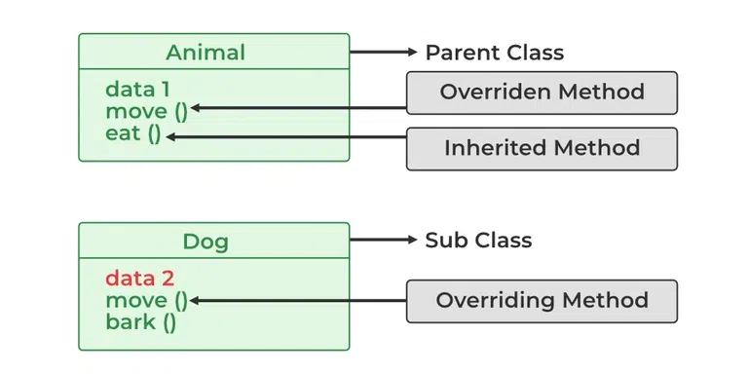
What is Method Overriding?
Method Overriding allows a child class to provide a specific implementation of a method that is already defined in its parent class.
The method in the child class must have the same name, return type, and parameters as in the parent class.
Overriding is used for runtime polymorphism and enables dynamic method dispatch.

Slide 31
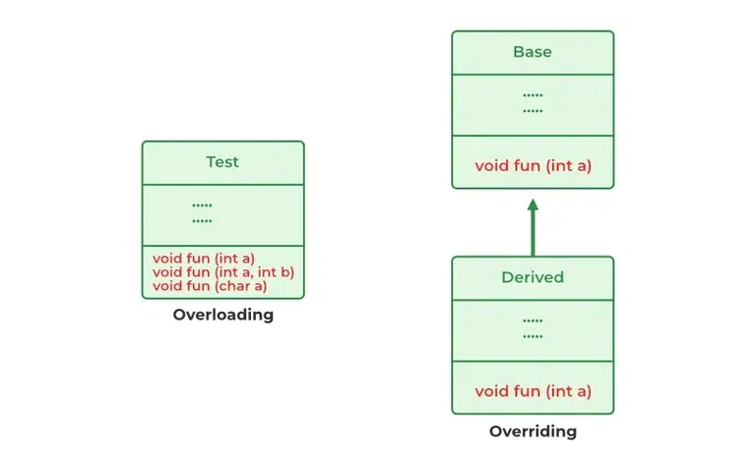

Slide 32
Syntax of Method Overriding
class Parent {
void show() {
System.out.println("This is the Parent class");
}
}
class Child extends Parent {
@Override
void show() { // Overriding the method
System.out.println("This is the Child class");
}
}
public class Main {
public static void main(String[] args) {
Parent obj = new Child(); // Upcasting
obj.show(); // Calls overridden method in Child class
}
}

Slide 33
Rules for Method Overriding
Method signature (name, parameters) must be the same. The overridden method cannot be more restrictive in access modifier:
public → Must stay public
protected → Can be protected or public, but not private
private methods cannot be overridden.
Final methods cannot be overridden (methods marked as final).
Static methods cannot be overridden, but can be re-declared in the child class.

Slide 34
Access Modifiers
class Parent {
private int privateVar = 10; // ❌ Not inherited
int defaultVar = 20; // ✅ Inherited (same package only)
protected int protectedVar = 30; // ✅ Inherited (even in subclass outside package)
public int publicVar = 40; // ✅ Always inherited
}
class Child extends Parent {
void display() {
// System.out.println(privateVar); // ❌ Error: private not accessible
System.out.println(defaultVar); // ✅ Accessible (same package)
System.out.println(protectedVar); // ✅ Accessible
System.out.println(publicVar); // ✅ Accessible
}
}

Slide 35
Using super in Inheritance
Calls the parent class method inside the child class.
Helps in method overriding and constructor chaining
class Parent {
void display() {
System.out.println("This is the Parent method");
}
}
class Child extends Parent {
void display() {
super.display(); // Calls the parent method
System.out.println("This is the Child method");
}
}

Slide 36
Best Practices for Inheritance & Access Modifiers
Use protected carefully – Only when subclasses need access.
Keep fields private and provide getters/setters for encapsulation.
Use super to call parent methods in overridden methods.
Avoid deep inheritance chains – They make debugging difficult.
Favor composition over inheritance when possible.

